Slide 1
What’s new and upcoming
CET Designer User Conference October 2012
Nicklas Dagersten, Configura

Slide 2
High Detail in Realtime 3D
User Choice
High detail on close objects

Slide 3
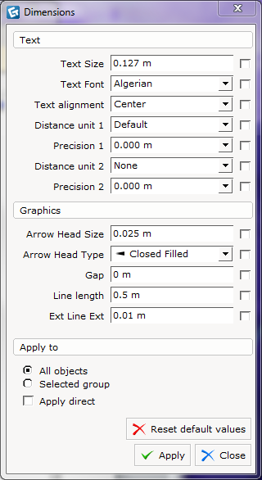
Dimension Settings
More Options
Global Change

Slide 4
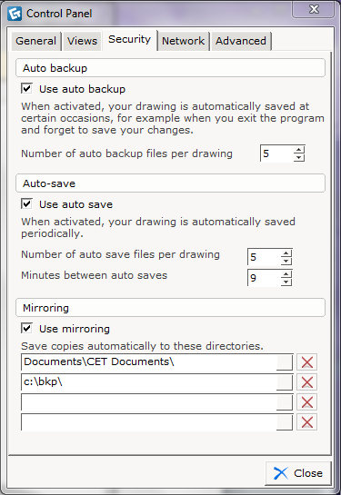
Load / Save
10 times faster
5 times smaller file
File Mirroring

Slide 5
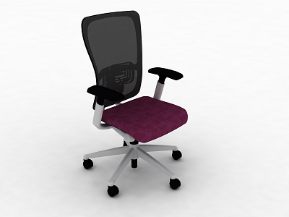
Product Lighting
Easy and Fast

Slide 6
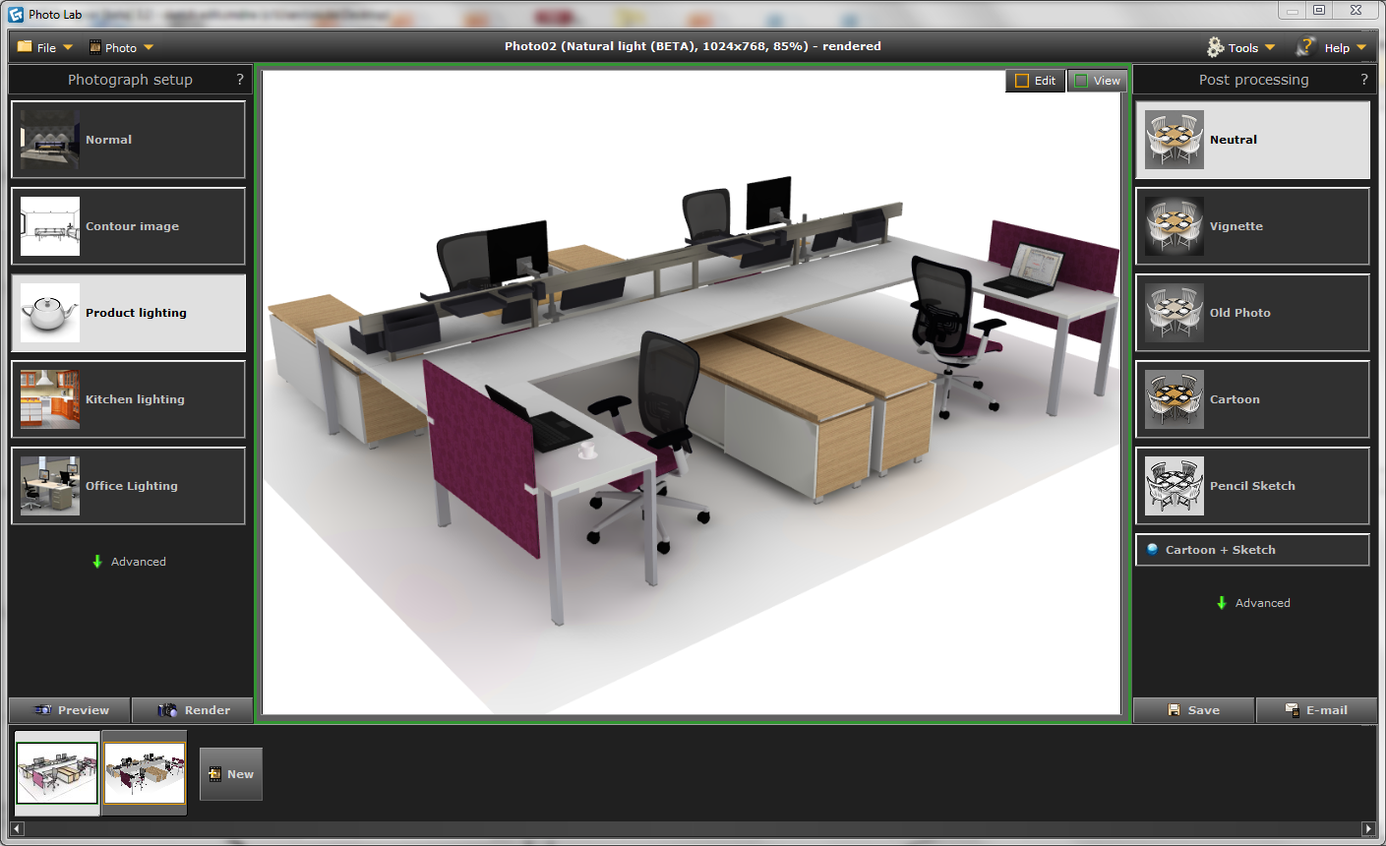

Slide 7
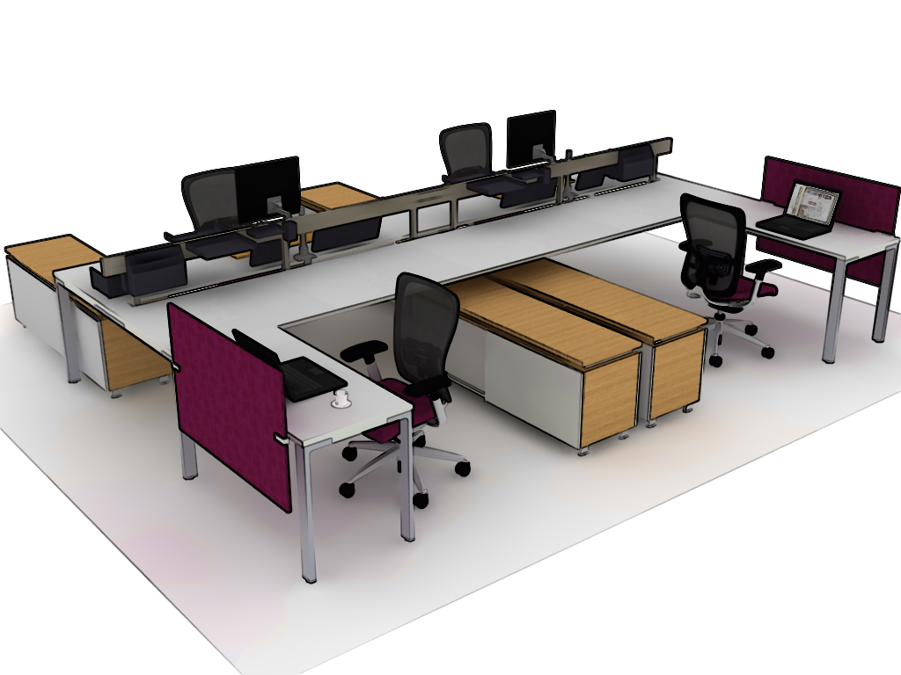
Cartoon

Slide 8
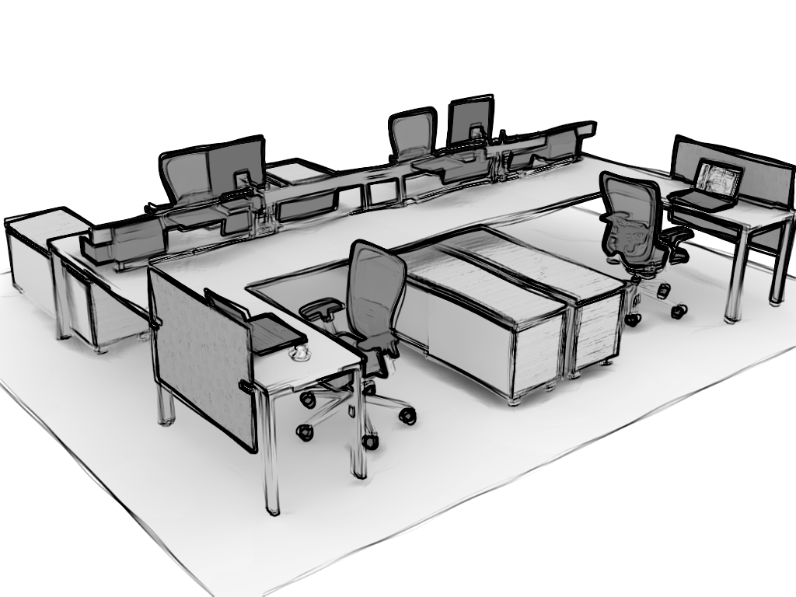
Pencil Sketch

Slide 9
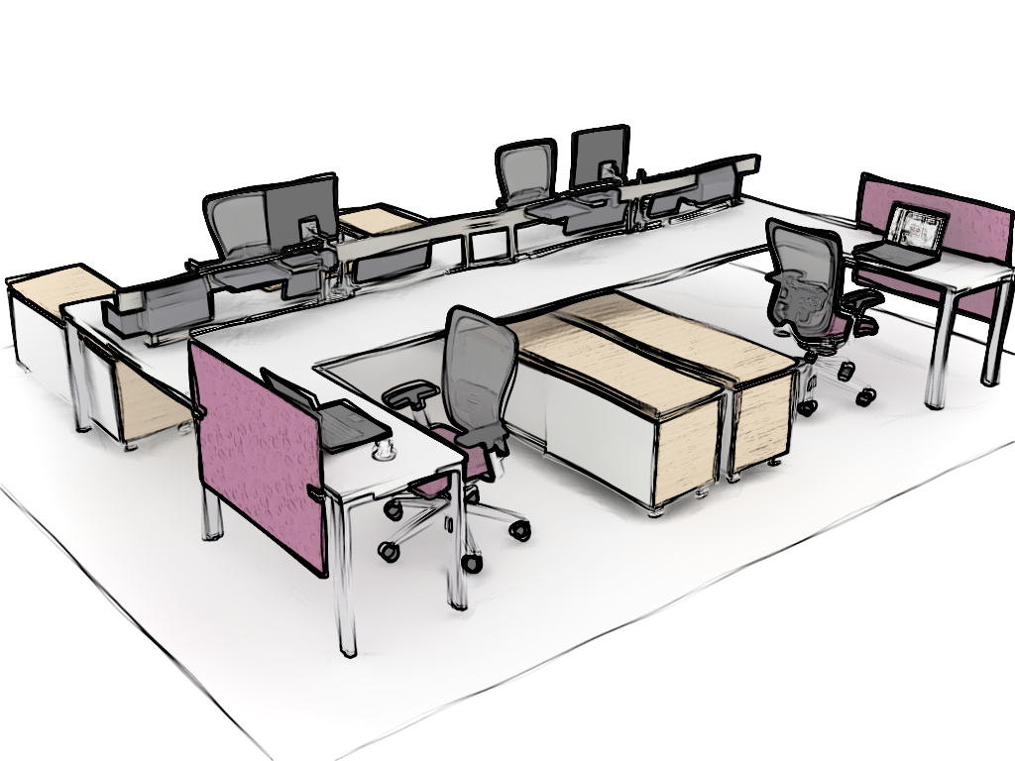
Cartoon + Sketch

Slide 10
What’s next
Revlink support for Revit 2012 and 2013
Dimensions / line drawing improvements
Text improvements
Visibility / Categories improvements

